Slide 1
Lectures
Tutorials
Student Presentations
Homework Assignments
Mid-Term Exam
Final Exam
Course
Format
Grading
 | Percentage
Homework assignments | 10
Presentations | 10
Mid-term exam | 30
Final exam | 50
Extra credit exercise (nonpunitive pop quizzes) | 1~2

Slide 2
Exercises of Chapter 1-2

Slide 3
Which of the following is NOT a property of life?
A
A) Populations of organisms rarely change over time.
B) Living things exhibit complex but ordered organization.
C) Organisms take in energy and use it to perform all of life's activities.
D) Organisms reproduce their own kind.

Slide 4
(2) What are the two main processes upon which ecosystems depend?
B
A) speciation and evolution
B) nutrient recycling and energy flow
C) decomposition and nutrient recycling
D) sunlight and photosynthesis

Slide 5
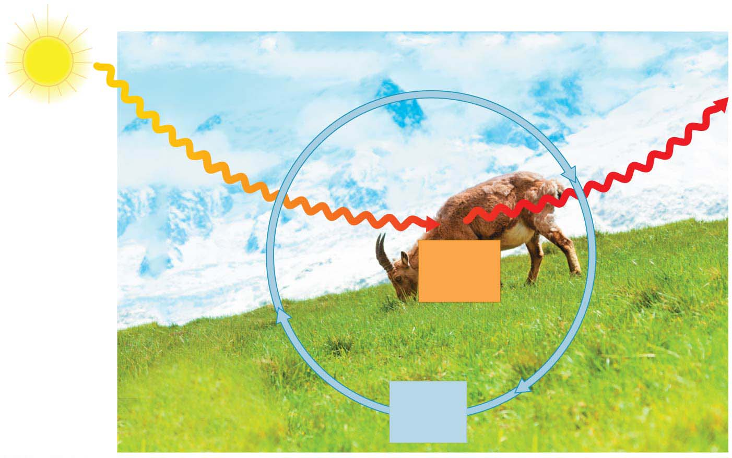
Inflow
of light
energy
ECOSYSTEM
Outflow
of heat
energy
Flow of energy
Consumers
(animals)
Chemical
energy
(food)
Producers
(plants and other
photosynthetic
organisms)
Decomposers
(in soil)
Cycling
of
nutrients
Notes:
Figure 1.19 Nutrient and energy flow in an ecosystem

Slide 6
(3) Which of the following is a producer?
A
A) oak tree
B) earthworm
C) sun
D) cat

Slide 7
(4) Which of the following structures can perform all the activities required for life?
B
A) DNA molecules
B) cells
C) organelles
D) nuclei

Slide 8
(5) Which kingdom of Eukarya consists primarily of unicellular organisms?
D
A) Plantae
B) Bacteria
C) Fungi
D) Protista

Slide 9
(6) The four most common elements found in living organisms are __.
B
A) nitrogen, oxygen, phosphorus, and carbon
B) carbon, oxygen, nitrogen, and hydrogen
C) carbon, oxygen, potassium, and calcium
D) oxygen, calcium, hydrogen, and carbon

Slide 10
(7) An uncharged atom of gold has an atomic number of 79 and an atomic mass of 197. This atom has ________ protons, ________ neutrons, and ________ electrons.
A
A) 79... 118... 79
B) 118... 79... 118
C) 118... 276... 118
D) 79... 34... 79

Slide 11
Sweating cools your body by ________.
C
A) cohesion
B) radiation
C) evaporative cooling
D) hydrogen bonding

Slide 12
(9) Which of the following is NOT a potential impact of ocean acidification?
A
A) Decreasing H⁺ concentrations
B) Coral bleaching
C) Changes in metabolism of marine animals
D) Increasing carbonic acid concentrations

